Slide 1
Medical Assistant Program
Information Session
Notes:
Lea to introduce

Slide 2
Table of Contents
Meet the Instructors
What is a Medical Assistant
Program Description and Overview
Program Requirements
How to Be Successful
Notes:
Lea: Go over TOC

Slide 3
Meet the Instructors

Slide 4
Meet Your Instructors!
Priscilla Manickam-Seng pseng@rtc.edu
I have been an Instructor for 8 years and have 12+ years of working as a MA for Family Practice, Internal Medicine, and Pediatrics. I travelled to work in Southeast Asia to help train healthcare workers and translate for foreign medical teams in a local hospital.
I love teaching and learning about every student’s unique life’s journey. I enjoy chillin’ with my family and friends, sunshine and beaches.

Slide 5
Lea Hoffman lhoffman@rtc.edu
I have been teaching full-time at RTC for 8 years and have worked as a medical assistant for 13 years primarily in pediatrics. I have a passion for healthcare and education. For me, getting an education was the catalyst I needed to get to work and gain financial independence, self-confidence, and empowerment. I completed my bachelor’s and master’s degree while working full-time. I love sharing my passion for learning with students and working with them to accomplish their goals.
Besides teaching I love music, dancing, traveling, the ocean and fitness.

Slide 6
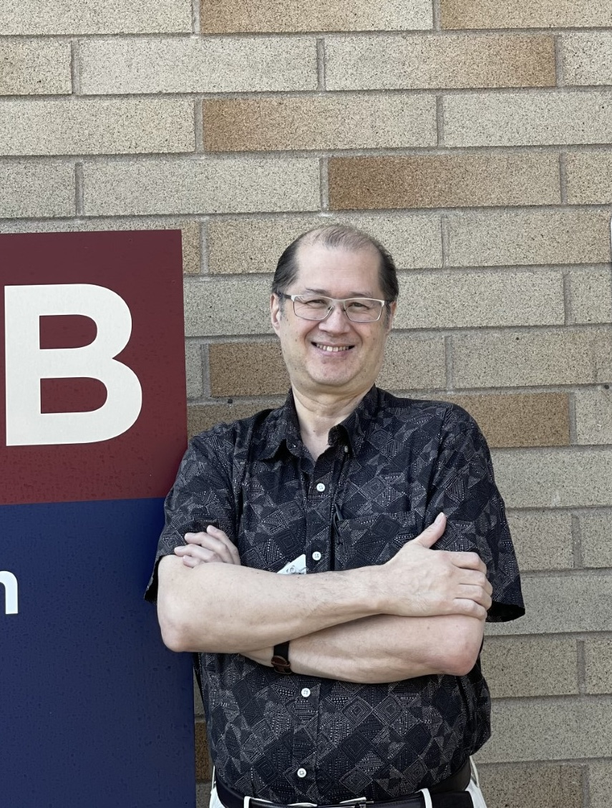
Jim Robinson jrobinson@rtc.edu
I began teaching the Medical Assistant program for various colleges in the beginning of 2000. Renton Technical College has been my full-time employer since the fall of 2014. I started in the healthcare field in the winter of 1989 and have worked in family practice and internal medicine. Prior to all of this, I served in the United States Air Force. Over the years, I earned my Bachelor’s, and Master’s degrees while working 40+ hours a week. When I’m not teaching the Medical Assistant program, you can find me on hiking trails with my wife, Jennifer. Although my degrees are in the field of psychology, I began as a performance art major.

Slide 7
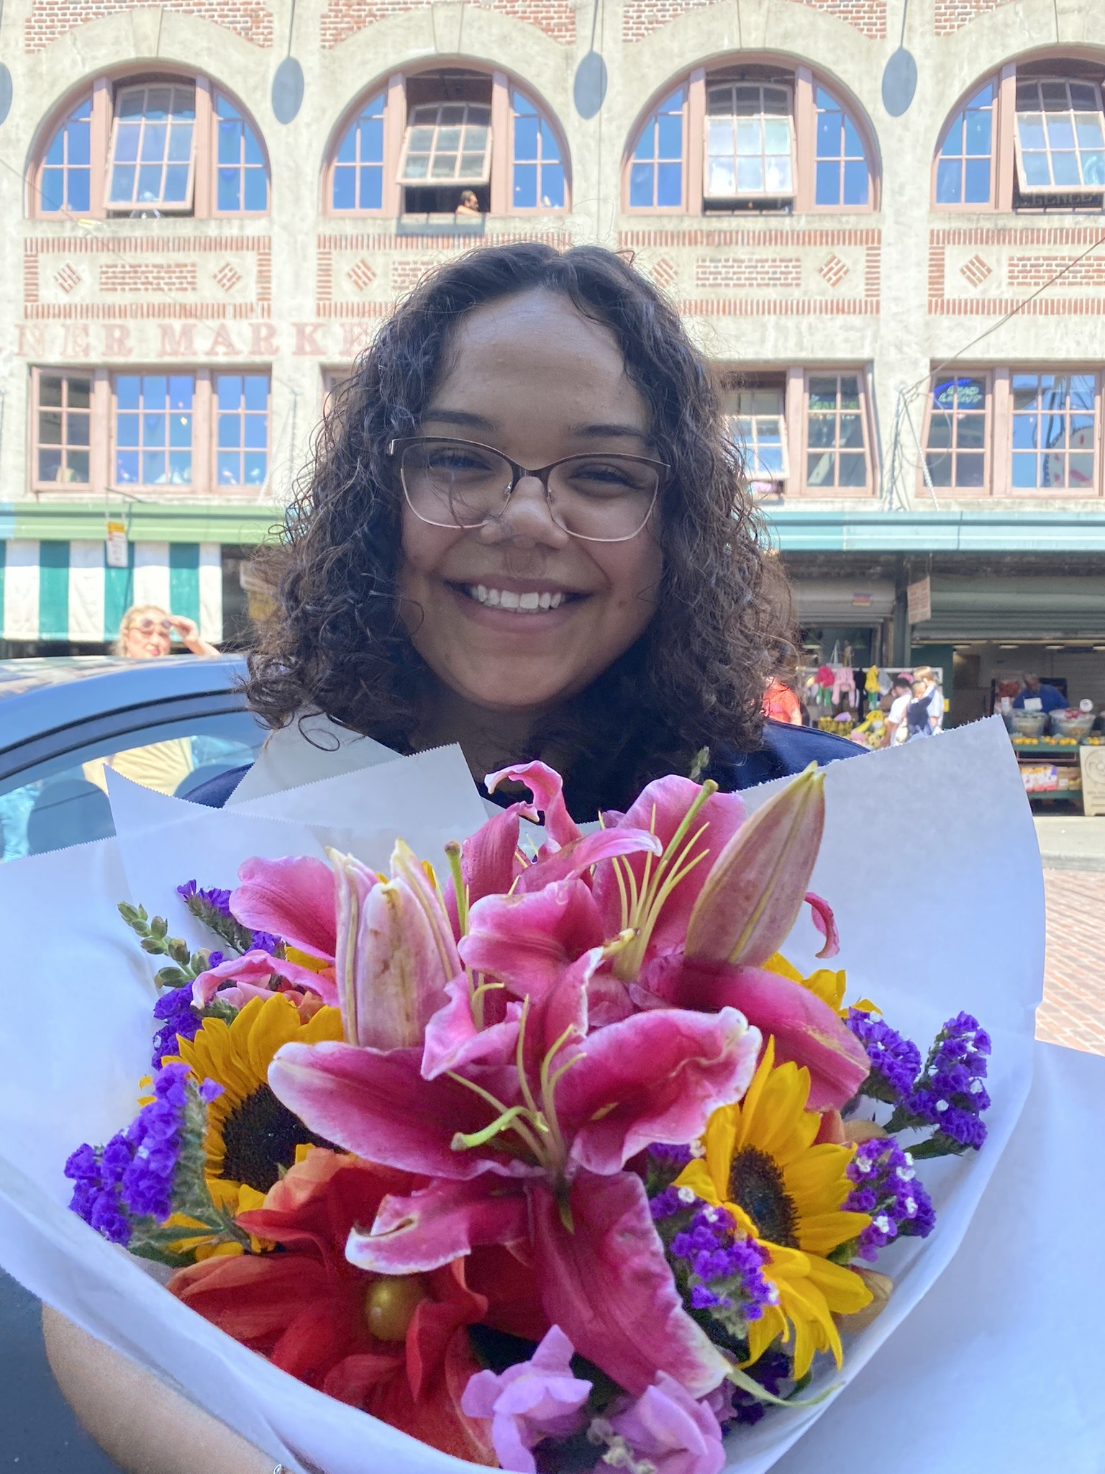
Fatima Rodriguez frodriguez@rtc.edu
I am your new Medical Assistant Clinic Instructor. Prior to accepting this opportunity, I worked in Pediatrics as a Medical Assistant. I am an alumni of the RTC Medical Assisting program and decided to continue my education here at RTC by completing my associated degree. I’m excited to grow with you all in this new journey.
I enjoy learning new things and teaching others. I love baking, making new recipes and spending time with family.

Slide 8
Eunice Graham egraham@rtc.edu
I have been teaching as the IBEST instructor in the MA program for several years. I am a former registered nurse who worked in public health, with a BS in nursing. My later-life specialty now is adult basic education. I am passionate about helping students succeed in all aspects of the MA program. I taught English as a Foreign Language for two years in China.
I like urban hiking, folk dancing, and ukulele singalongs in my free time.

Slide 9
What is a Medical Assistant?
Medical assistants work in the frontlines of medical care, helping physicians and specialists with medical procedures and administrative duties. It is a good profession for someone who wants to quickly enter the field of healthcare.
Notes:
Lea

Slide 10
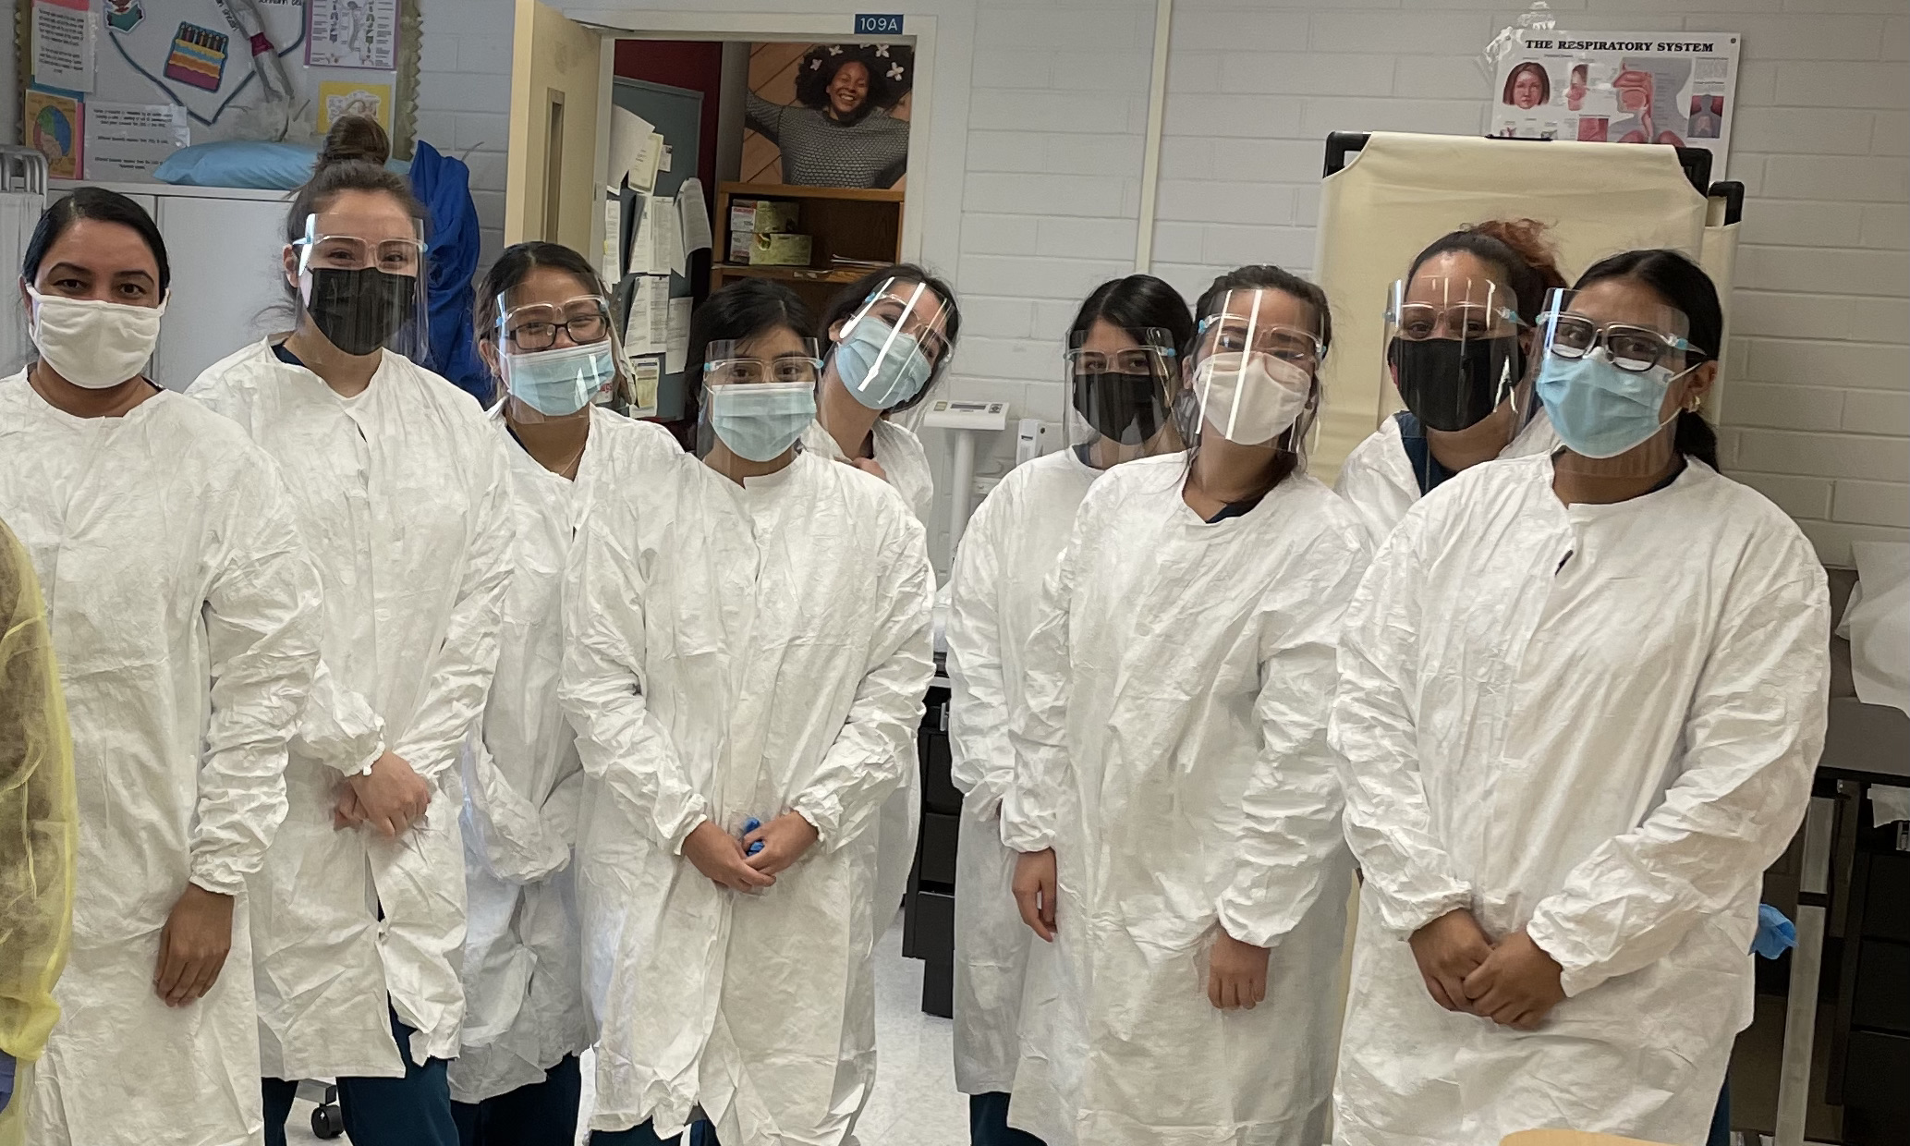
Program Description and Overview
Notes:
Lea

Slide 11
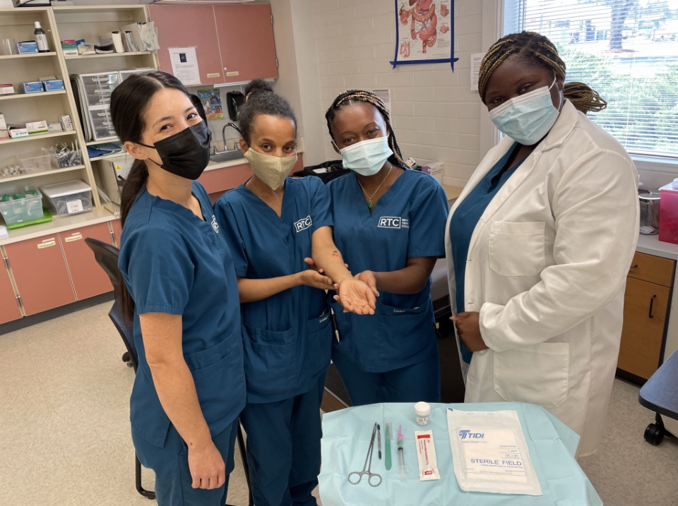
Program Overview:
4 quarters
2 Enrollment Points
Fall Cohort (Day and Evening)
Winter Cohort-January (Day)
Intense program-18-20 credits per quarter
Hybrid Program
Notes:
Lea

Slide 12
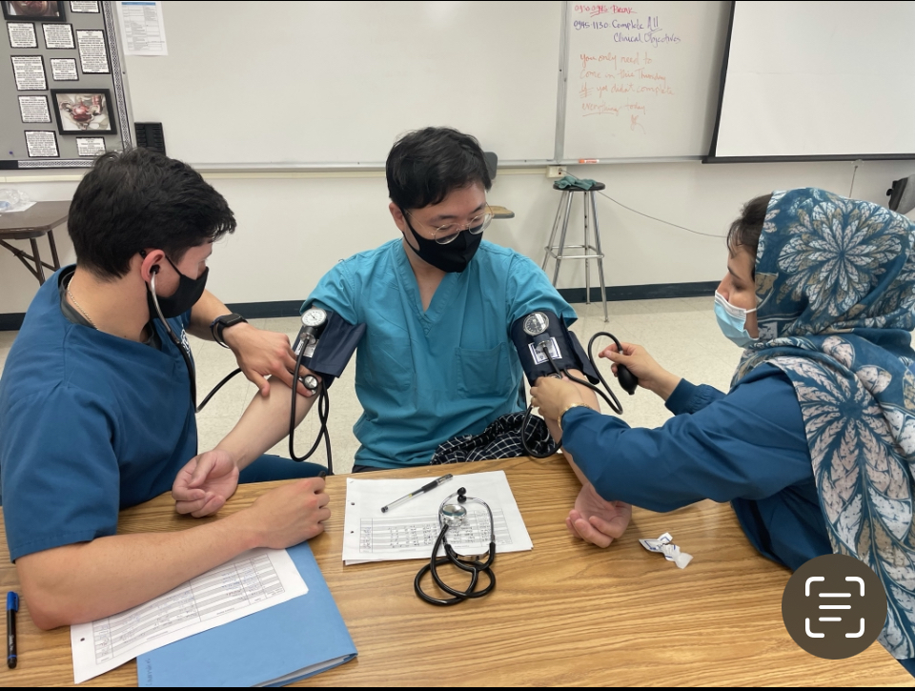
Courses
Some of the courses include:
Anatomy and Physiology, Clinical Procedures, Administrative Procedures, Insurance Billing and Coding, Human Health, Disease and Treatment, and Practicum Seminar
Notes:
Priscilla

Slide 13
What is a Hybrid Program
Combination of learning both online and in a classroom setting
Notes:
Priscilla

Slide 14
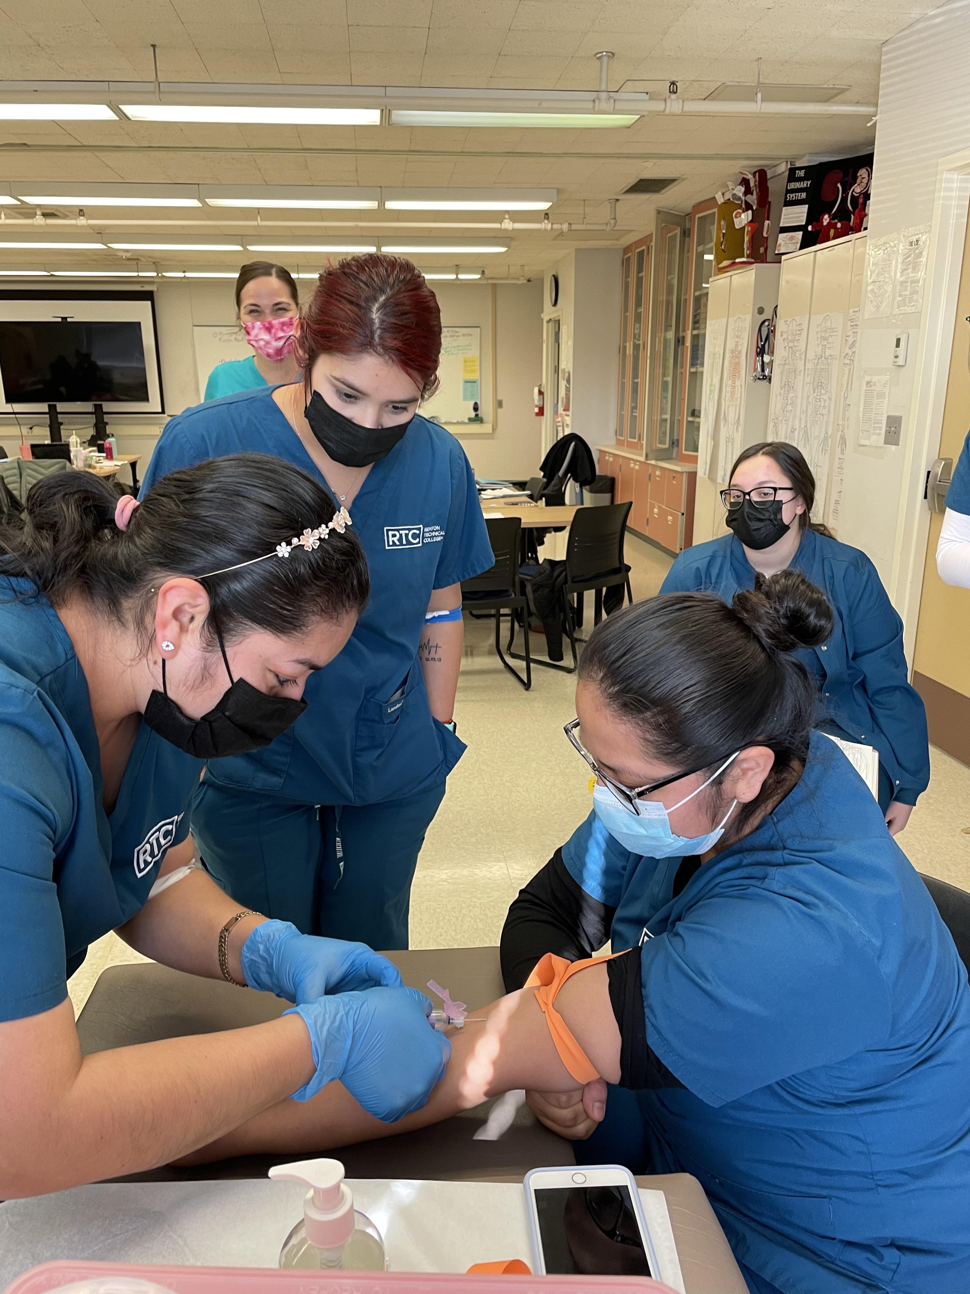
Clinical Skills
You will practice the following skills in class
Gathering patient history
Administer injections
Perform blood draws
Perform vital signs
Perform EKGs
Perform Spirometry
Perform CLIA-waived lab testing
Assist with minor office procedures
Notes:
Fatima

Slide 15
What is I-BEST?
I-BEST is designed to support student learning in college training programs.
As an I-BEST student, you will receive more support than in a traditional college program.
The I-BEST instructor helps students be successful in the program and in the industry through extra support and help in all aspects of the program.
Integrated Basic Education & Skills Training
Notes:
Eunice

Slide 16
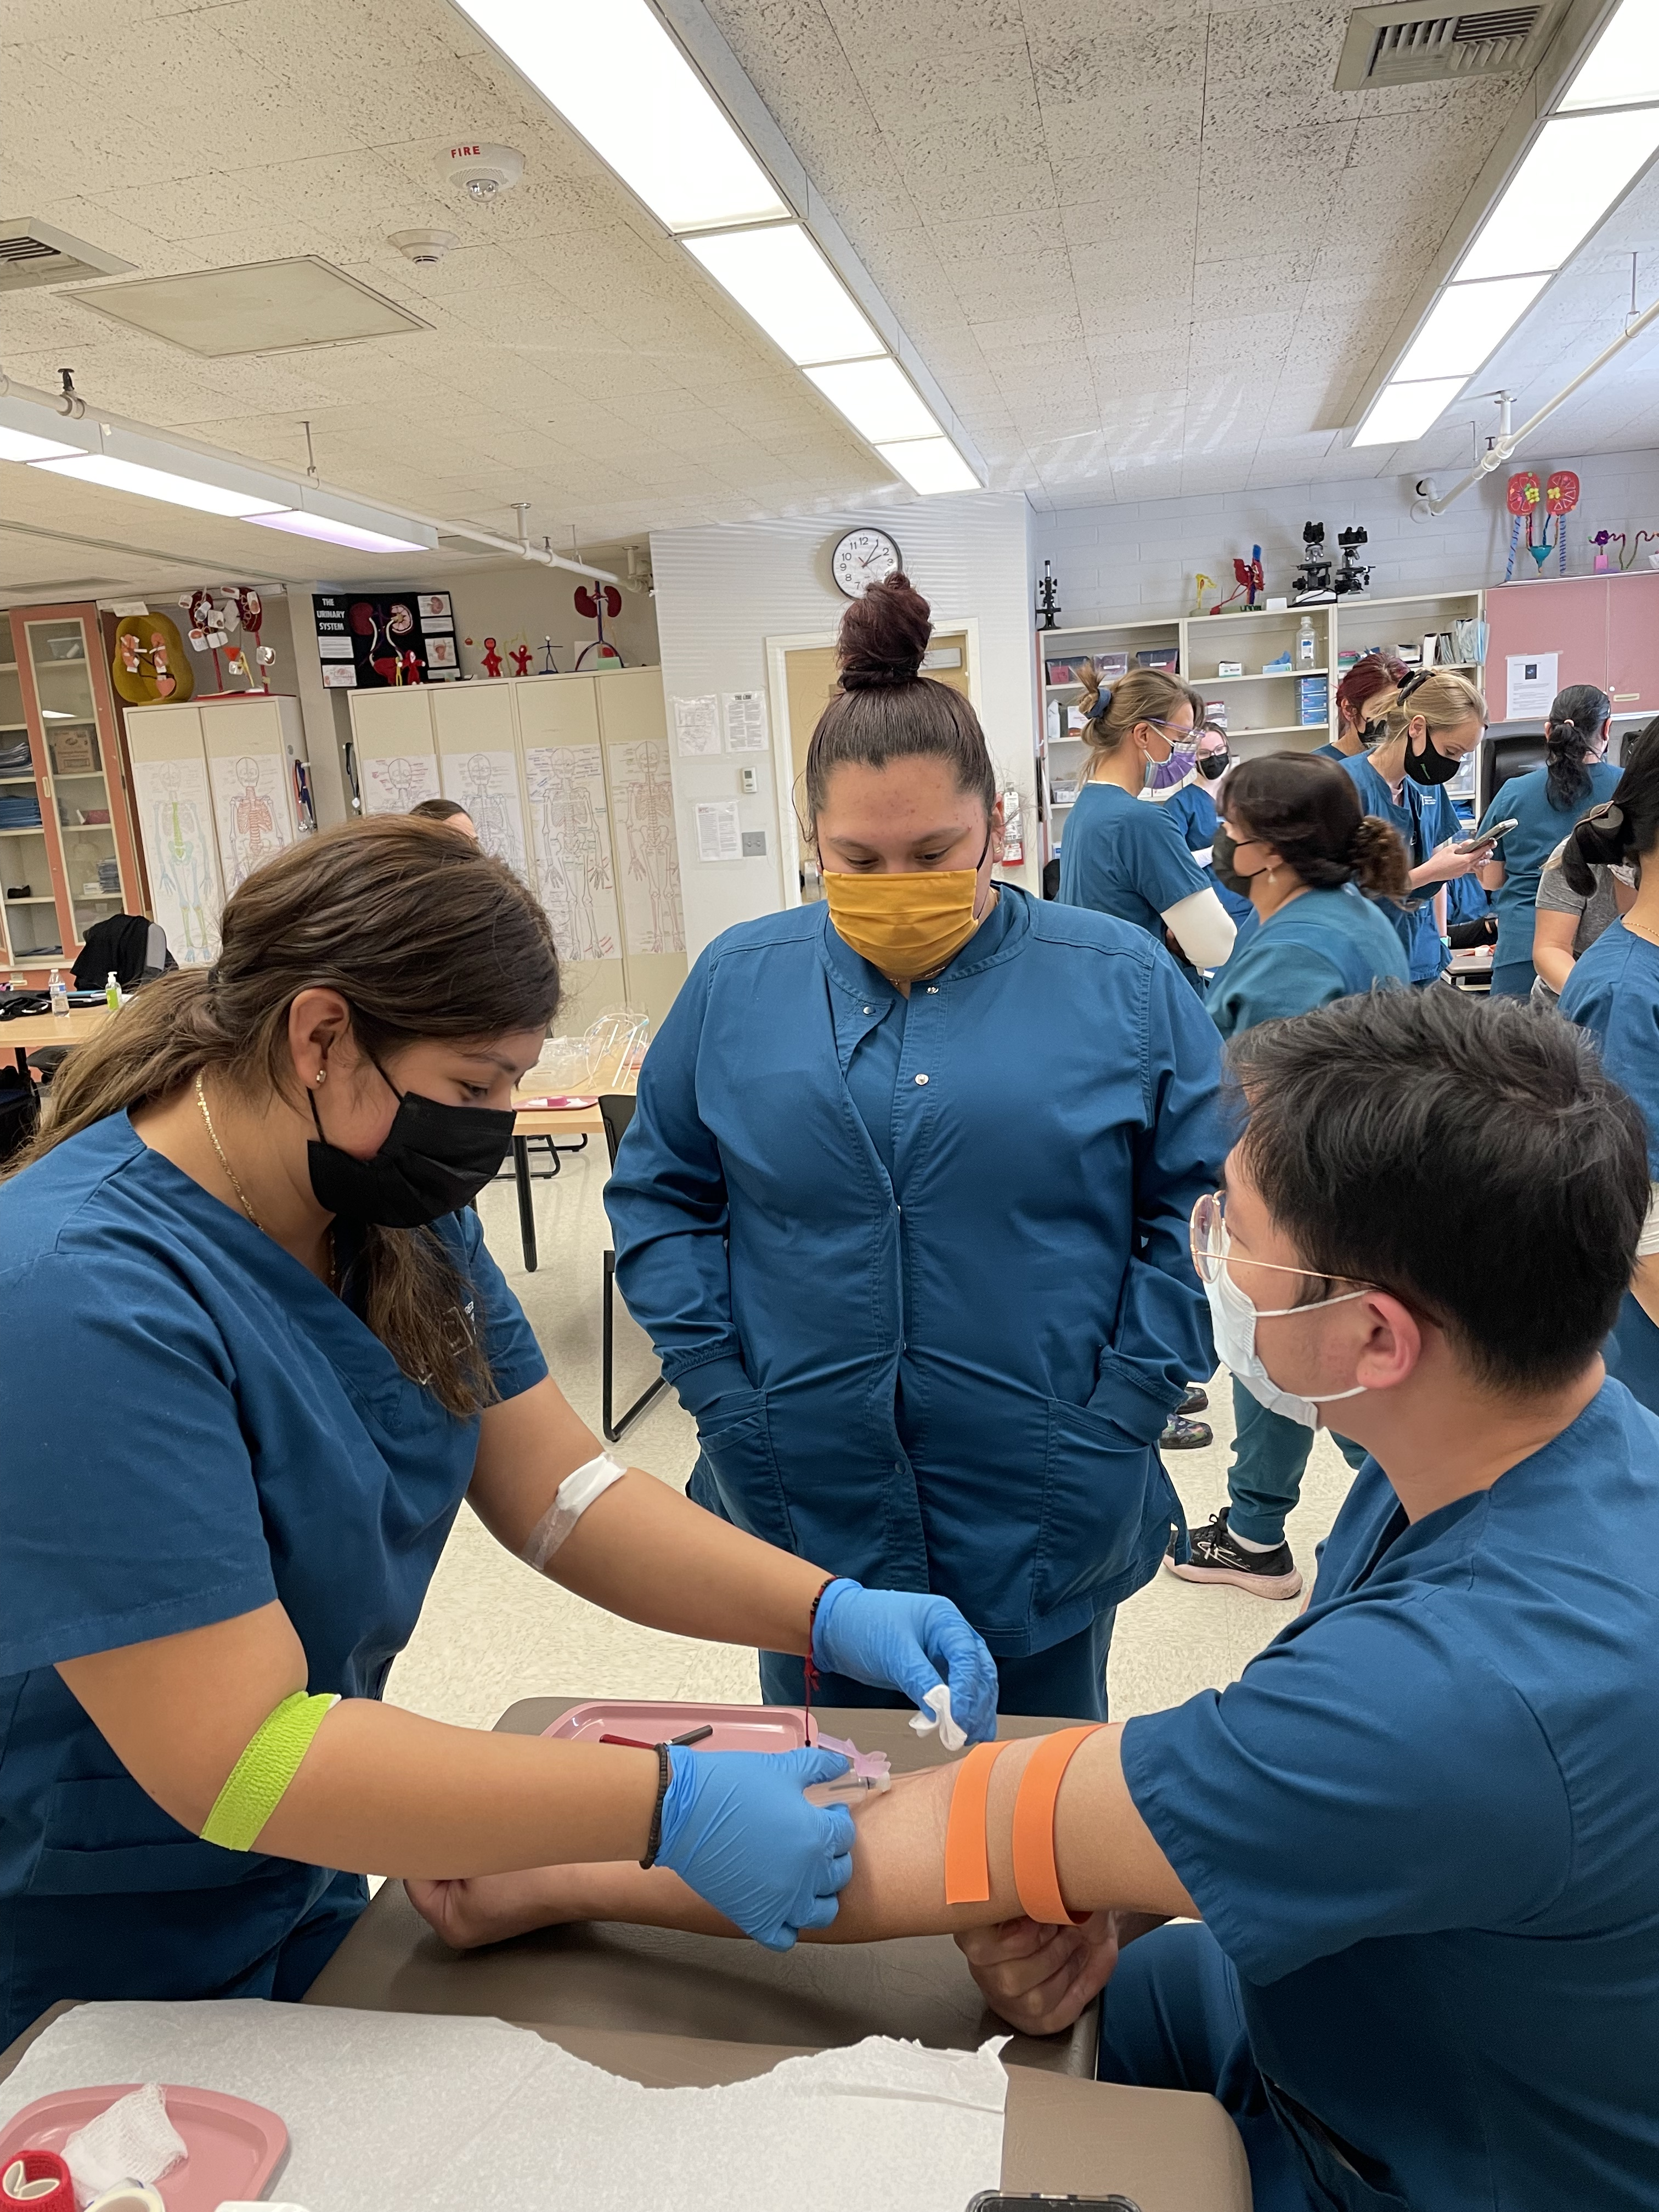
Practicum
160 unpaid clinical hours usually Monday-Friday 7:00 am-6:00 pm
Notes:
Lea

Slide 17
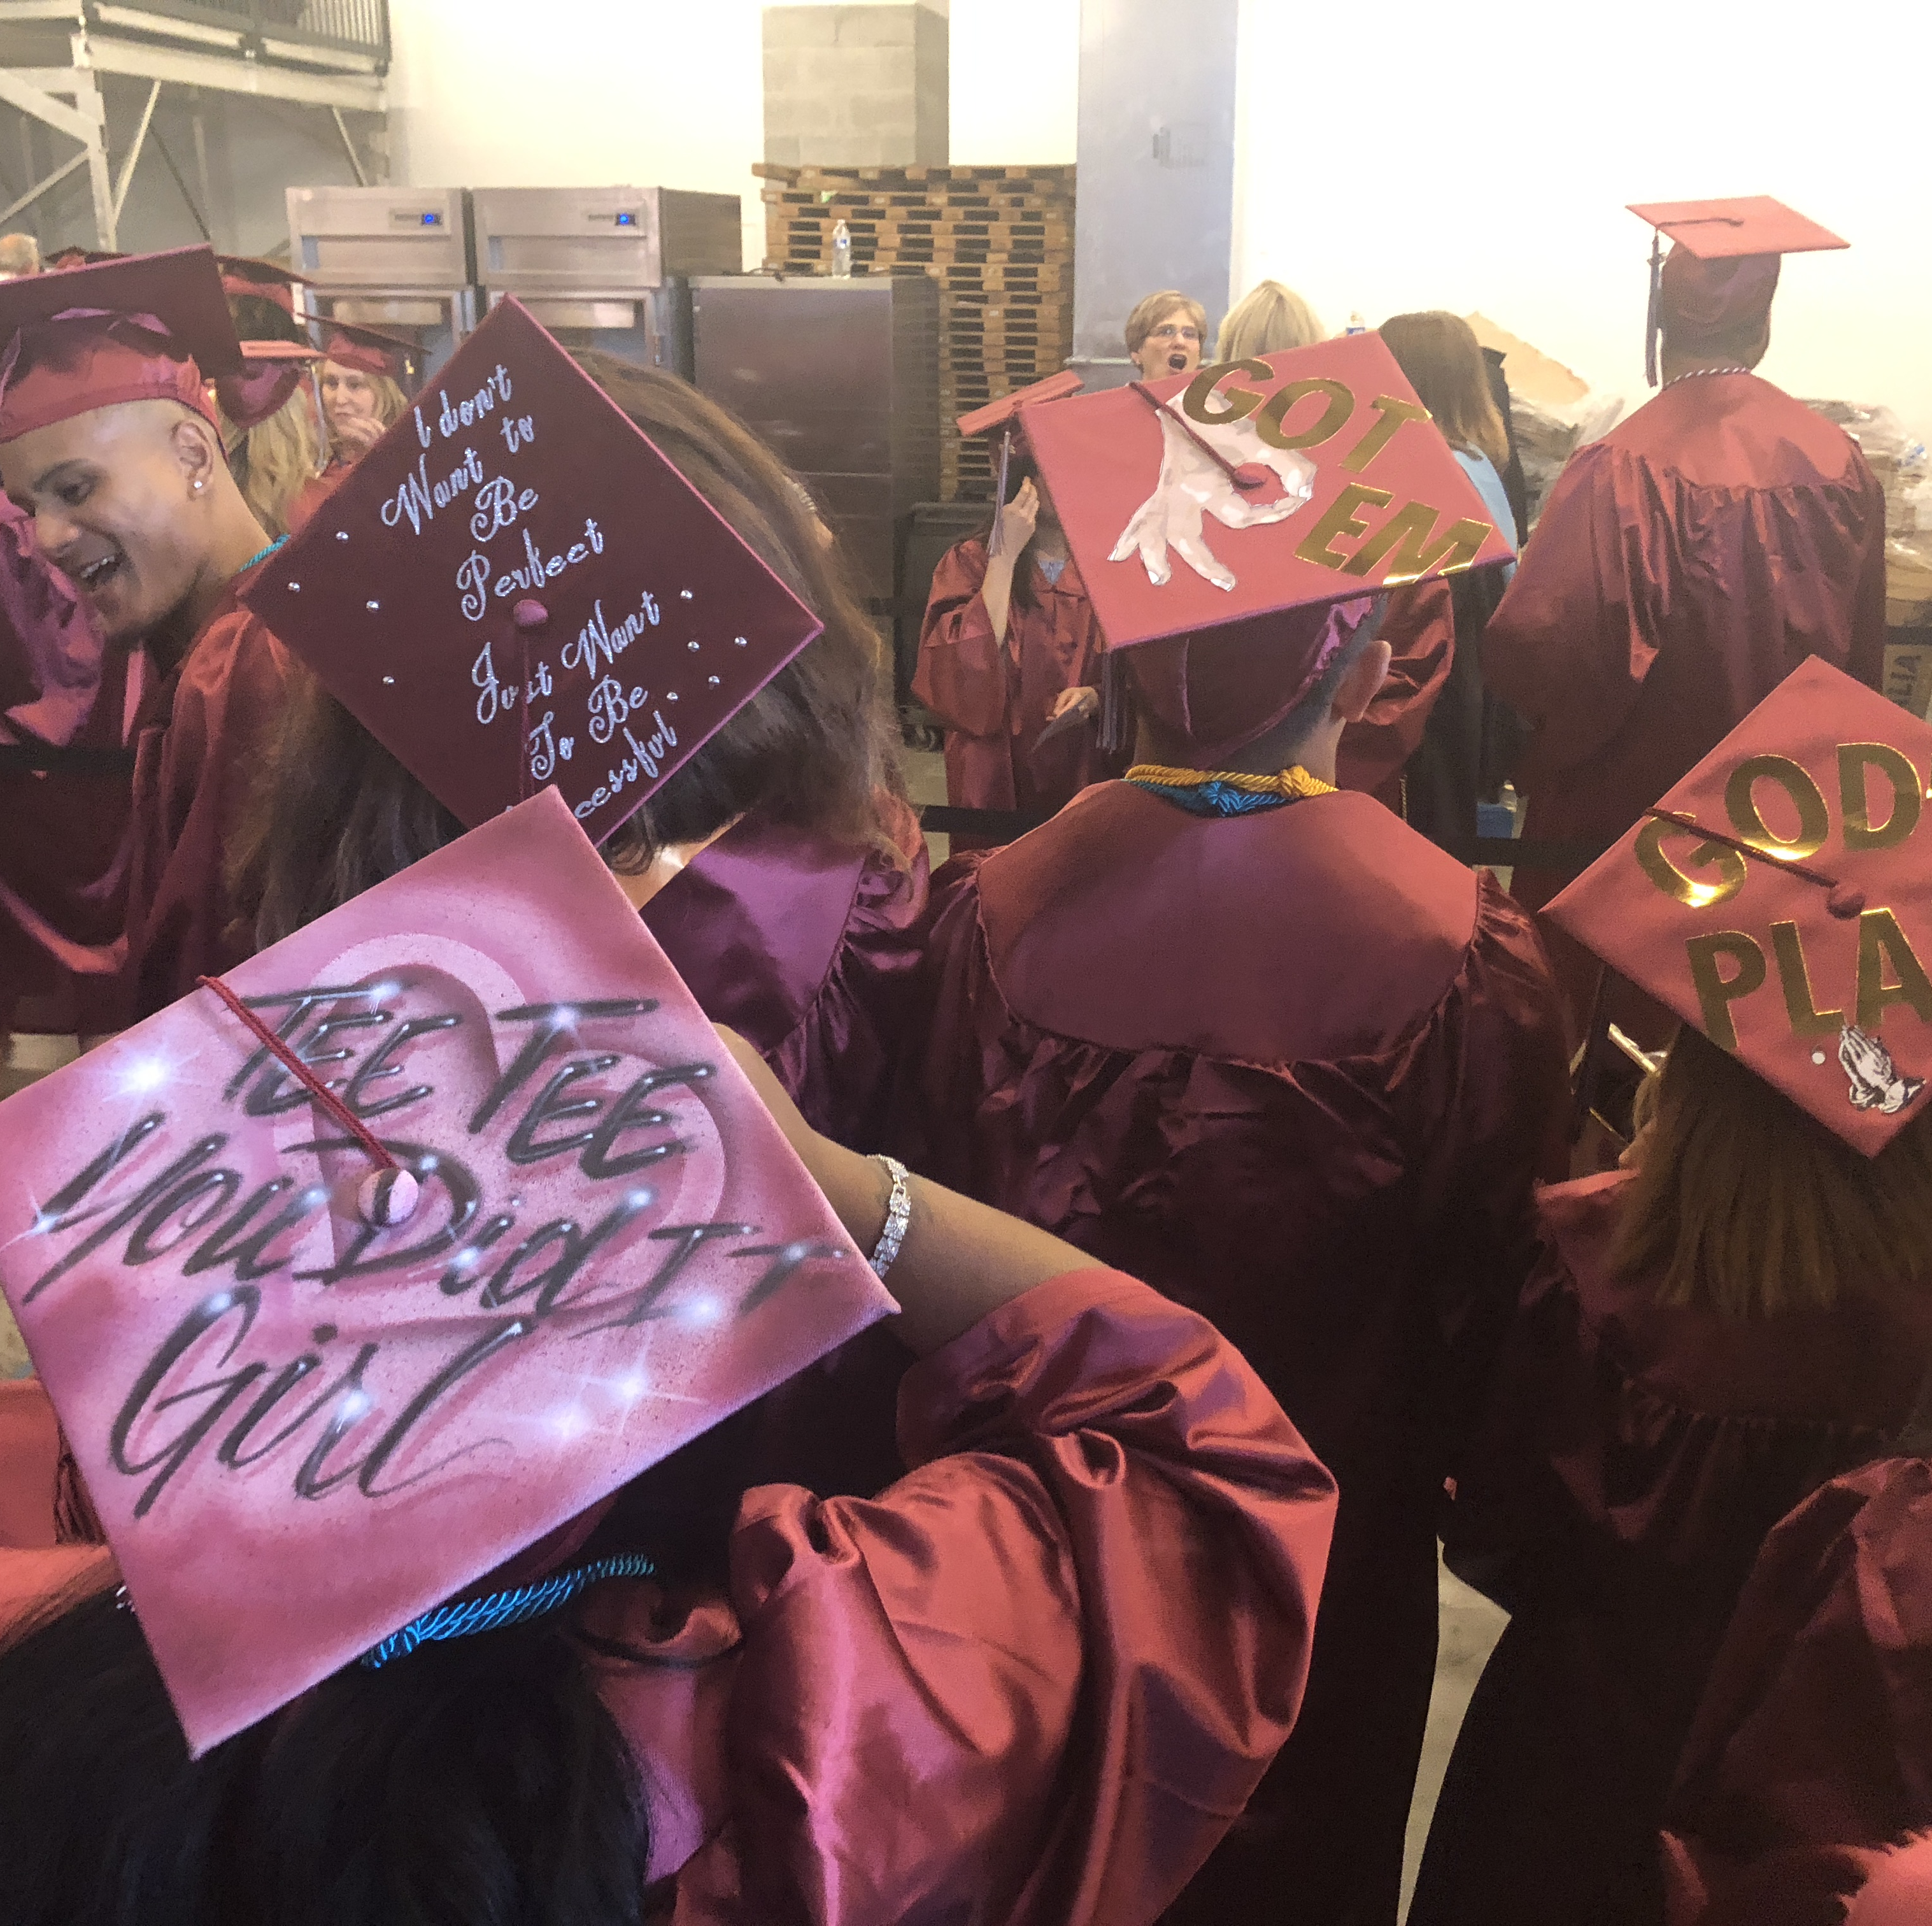
MA License and Exam
Prepare you to take and pass the national exam for medical assistants
Apply for your Washington State Medical Assistant License
Notes:
Lea

Slide 18
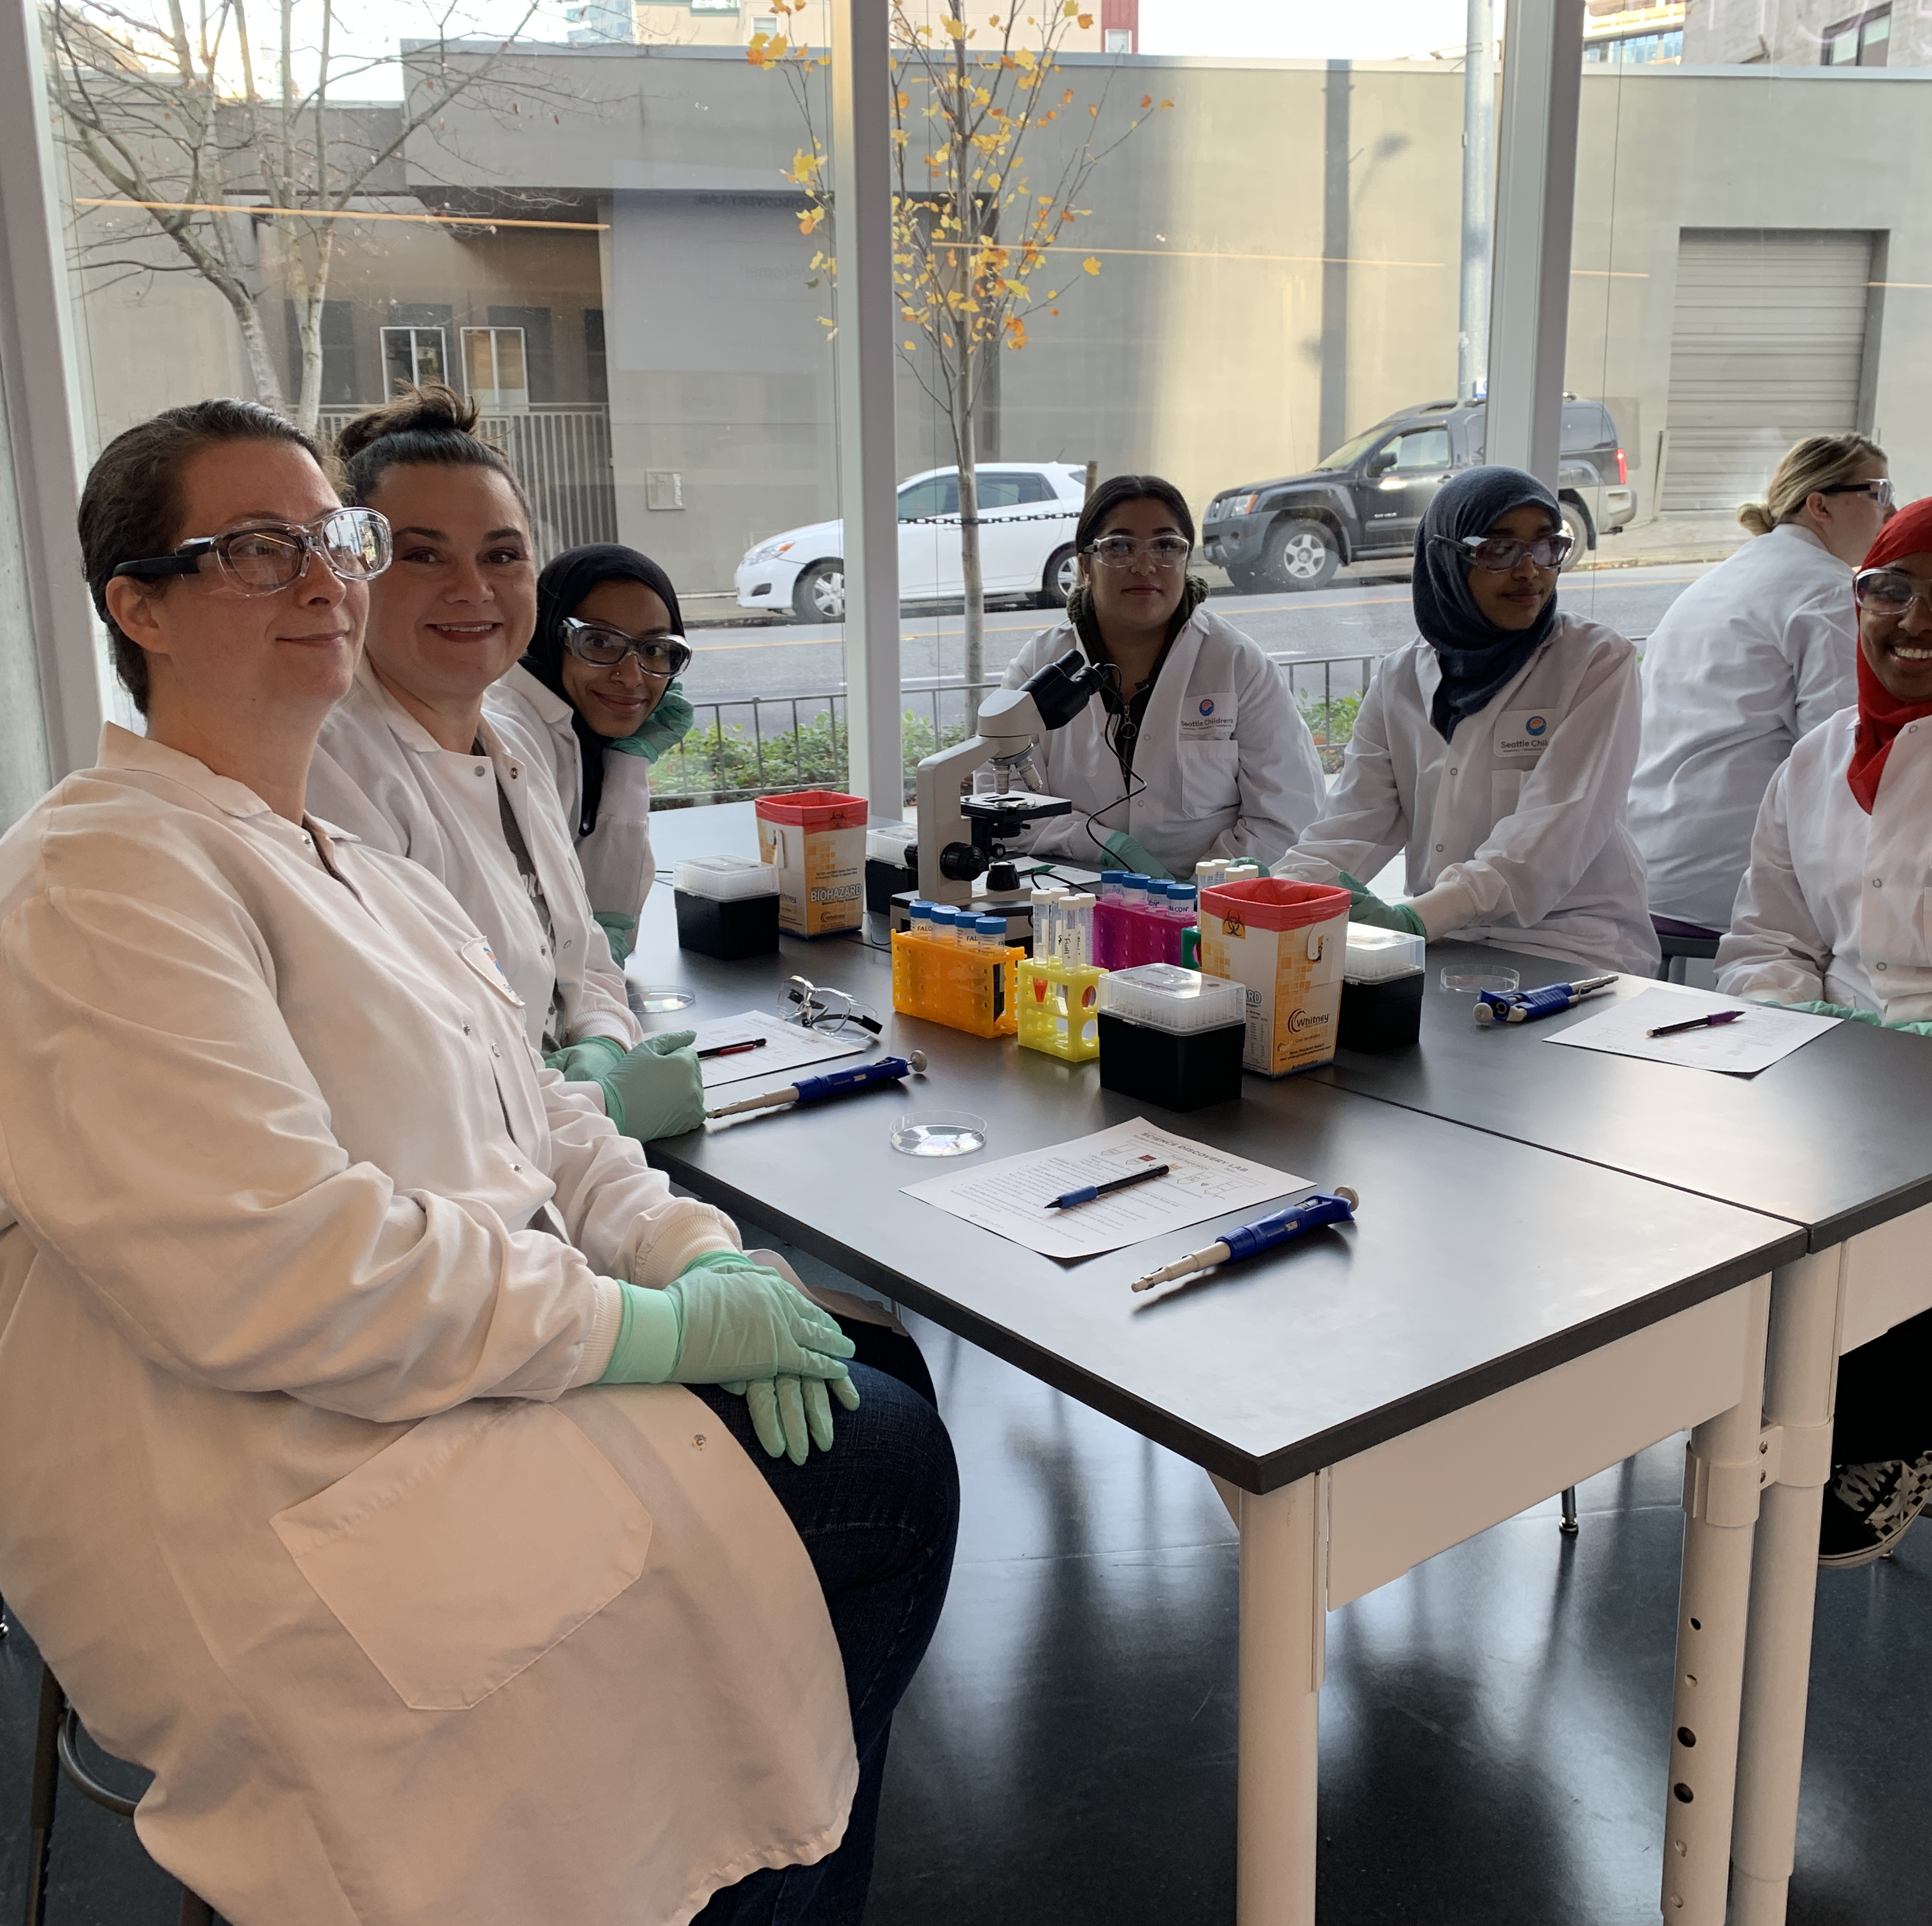
Statistics
100% satisfaction rates from graduates about the medical assistant program.
88% average retention rate for the program over the last five years
93% average passing rate for the national exam over the last five years.
Notes:
Jim

Slide 19
Program Requirements
Notes:
Jim

Slide 20
Program Entry Requirements
(High School student or) High School Diploma/GED (or equivalent) at time of enrollment
Effective verbal and written communication skills
Upon invitation and acceptance to the Medical Assistant Program, students must provide confirmation of an account established with CastleBranch.com and pass a nationwide criminal background check (Crimes Against Persons list).
Cost: $106 (do not create an account prior to invitation and registration to the program)
Notes:
Jim

Slide 21
Program Requirements
Have an active health insurance.
Computer and Internet Access
Computer competency.
Notes:
Jim

Slide 22
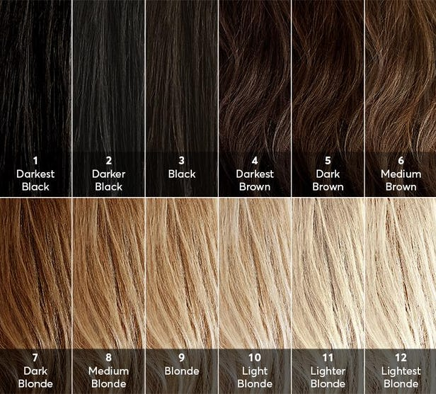
Program Requirements
Natural hair colored required. No rainbow colored permitted.
Natural fingernails. No Acrylics, no long nails, no colored nail polish permitted.
Notes:
Priscilla

Slide 23
Program Requirements
Facial and ear piercings should be limited to small studs.
Any tattoos that would not be acceptable should be covered.
Notes:
Priscilla

Slide 24
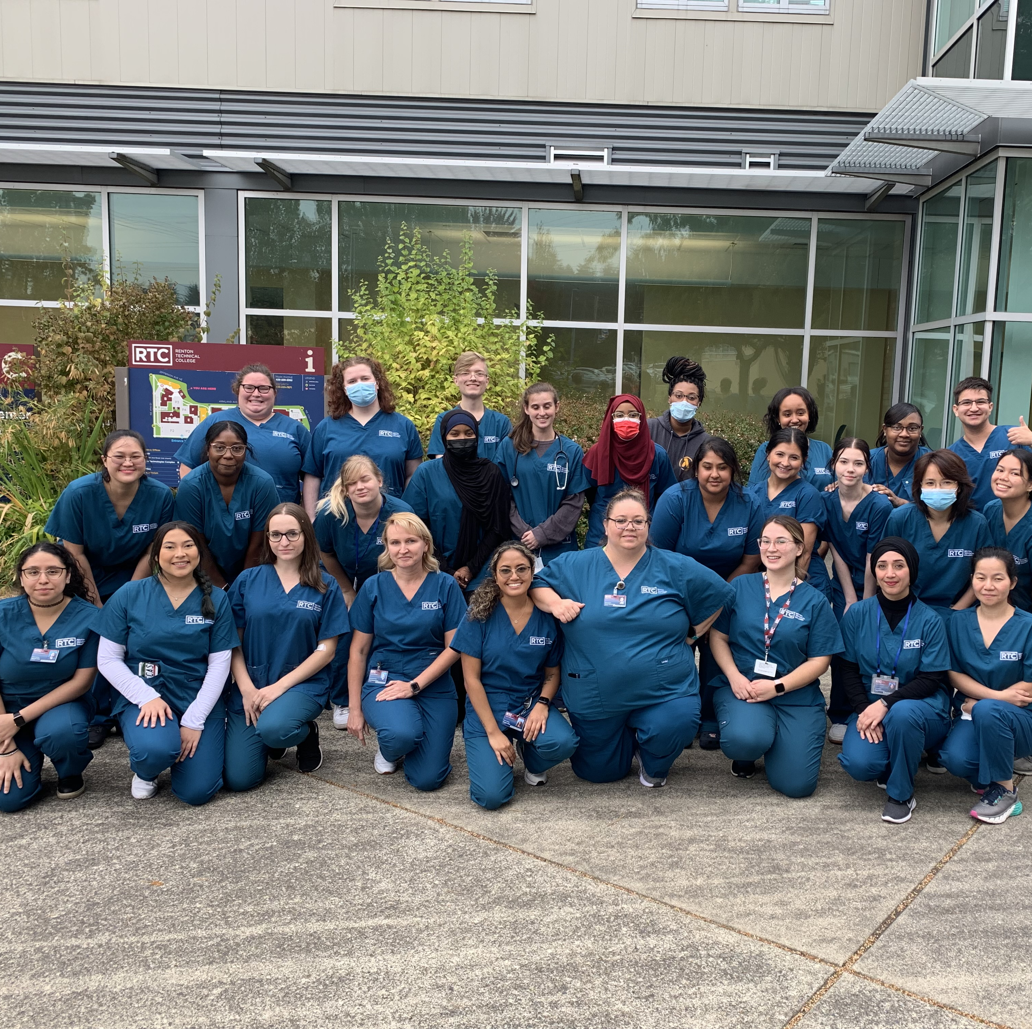
Dress Code
Scrubs must be worn every in-person class day. No hoodies.
Scrubs must be clean and wrinkle free.
Masks are optional.
Closed toed shoes are mandatory-no Ugg boots or Crocs with holes.
Notes:
Fatima

Slide 25
Program Overview: ONLINE LEARNING WITH CANVAS
The RTC MA program uses Canvas and it is vital that you have access to a computer and internet access.
Notes:
Jim

Slide 26
Required Textbooks and Subscription
Today’s Medical Assistant 4th Edition textbook and study guide.
Medical Terminology (Pearson) 3rd Edition
EHRGO 10-12 months subscription
Notes:
Jim

Slide 27
Required Materials
MA-Caribbean Blue RTC logo scrubs (2 sets)-lab coat (optional)
Stethoscope
BP cuff (optional)
Watch with a second hand
Latex free/powder free gloves
Blue/black ink pen, notebook paper
$95 CLINIC SUPPLY FEE (paid in second quarter)
Computer or laptop
Notes:
Jim

Slide 28
How To Be Successful
Time Management
Stay Engaged
Organization
Communication
Collaboration
Notes:
Eunice

